Slide 1
A smart point of care Ionized calcium detection device for dairy cows
Dr.S.Krishna kumar* and P.Kumaravel
*Associate Professor and Head
Department of Veterinary Public health and Epidemiology
Veterinary College and Research Institute, Udumalpet
epivetkrishna@gmail.com

Slide 2
Preamble
Hypocalcaemia, characterized by decrease in blood calcium below normal level
Most of the diary animals are in hypocalcaemia condition and looks normally.
Soon after calving, because high need of calcium leads to hypocalcaemia’s.
Most of the unattended/ delayed case of hypocalcaemia leads to Downer Cow Syndrome.
The outcome of the downer cow syndrome mainly depends upon the time of treatment, selection of salt , dose, route and other husbandry parameters.
Among the three forms of calcium in blood, the ionized calcium (iCa) is the physiologically active.

Slide 3
Preamble
The iCa concentration in blood normal between 1.05 and 1.30 mmol/L.
Hypocalcemia is diagnosed at 0.9 mmol/L
Early detection - Better intervention
Periodical herd iCa detection - Better productivity

Slide 4
Components of Calcium in blood

Slide 5
Current scenario
Very few facilities available to measure the ionized calcium that to in the urban based laboratories.
Most of the dairy farming are situated in the rural areas and testing laboratories are far away from the field.
Testing of ionized calcium facilities are also remote.

Slide 6
Intervention.
Planned to develop sensor based, hand held, point of care device to detect ionized blood calcium device equipped.
It will be affordable cost (if large volume is manufactured)
and rapid blood iCa analysis
Ideal for individual animal and herd-level monitoring of dairy farms.

Slide 7
Mechanism Sensor based Calcium determination
The Calcium sensor contains a Permafil (non-refillable) electrode containing an oxidized form of Calcium inside a membrane.
Calcium in the sample is attracted to the oxidized Calcium in the membrane.
By measuring the electrical potential of this attraction, the sensor can determine the level of Calcium in the solution.
Attract only Calcium molecules sealed electrode sensors work well even in solutions containing numerous elements.
Values converted in to iCa level in mmol/L

Slide 8
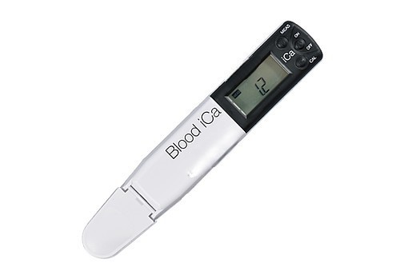
Hand held iCa detector

Slide 9
Procedure
Collect blood from animal and store in Heparin tubes
Allow it for room temp (20-25ºC)
Place one drop of blood in the Well
Wait for Two minutes
Read the results

Slide 10
Outcome
Point of care , more accurate results with affordable price
Quick and repeat treatment
Easy for differential diagnosis
Routine health check up at farm level
Effective management of feeding plan

Slide 11
Any suggestions
Any comments
Any questions
Thank you to all my co workers

