Slide 1
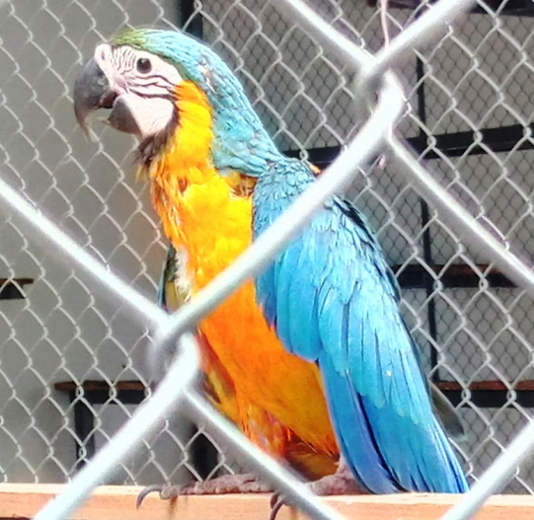
Exotic Newcastle Disease In Caged (Exotic) Birds
Dr.S.Krishna kumar,Ph.D.,
Assistant Professor,
Sheep Breeding Research Station,
Tamil Nadu Veterinary and Animal Sciences University

Slide 2
Background
Newcastle disease virus (NDV) -Paramyxoviridae family Avulavirus genus
NDV classified as
lentogenic (low- mild or subclinical respiratory infection )
mesogenic (intermediate- respiratory signs, occasional nervous signs, but low mortality )
velogenic (highly virulent - high mortality, usually following respiratory and nervous signs
Velogenic NDV isolates -via illegal importation of psittacine birds
Velogenic NDV also referred as exotic Newcastle disease (END)
(Ref:King DJ. Influence of chicken breed on pathogenicity evaluation of velogenic neurotropic Newcastle disease virus isolates from cormorants and turkeys. Avian Dis 1996;40(1):210–7)

Slide 3
Exotic Newcastle disease (END)
Etiology : Paramyxovirus serotype-1 (APMV-1)
IP : 2 to 17 days
Transmission : bird to bird contact, human activities, insects, rodents, cages, machinery equipment and infected eggs.
Host range : Cockatiels, budgies, amazons, cockatoos – high susceptible
Lory’s, macaws, canaries, finches, Mynah’s, African grey’s – Carrier
Clinical sign : Anorexia, diarrhea, paralysis, twisted neck, respiratory distress, ocular discharge, loss of weight and drop in hatchability etc.,

Slide 4
Research design
Epidemiological data analysis
Collection of clinical samples
Analysis of samples and interpretation of results
Therapeutic and prophylactic measures
Analysis of risk factors and designing plan for future

Slide 5
Location of the study area

Slide 6
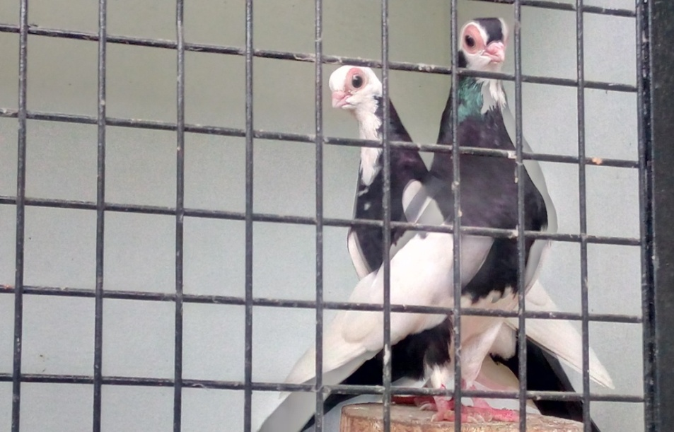
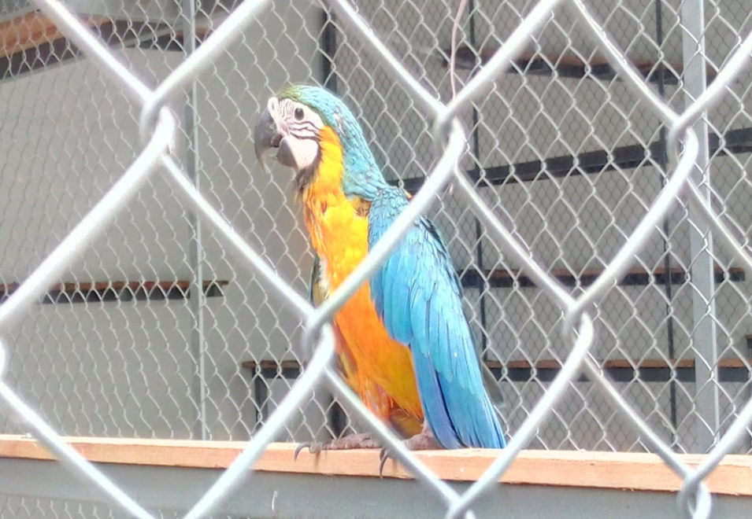
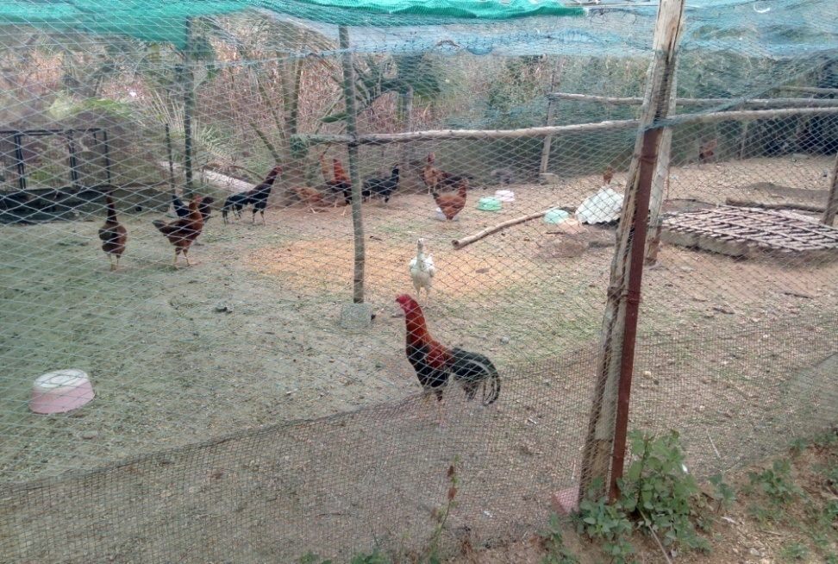
Farm at a glance

Slide 7
Farm data
Total
1058
Grey parrot
60
Fancy Pigeon
950
Desi chicken
48

Slide 8
Research spot
Location : Annur, Coimbatore district, Tamil nadu
Type of farm :Fancy/Exotic bird farm
Total no of birds : 1058
Type of housing :Cage
Purchasing pattern :Once in a month
Vaccination :Nil
Type of feeding :Mixed grain with supplements
Quarantine area : Inside the farm

Slide 9
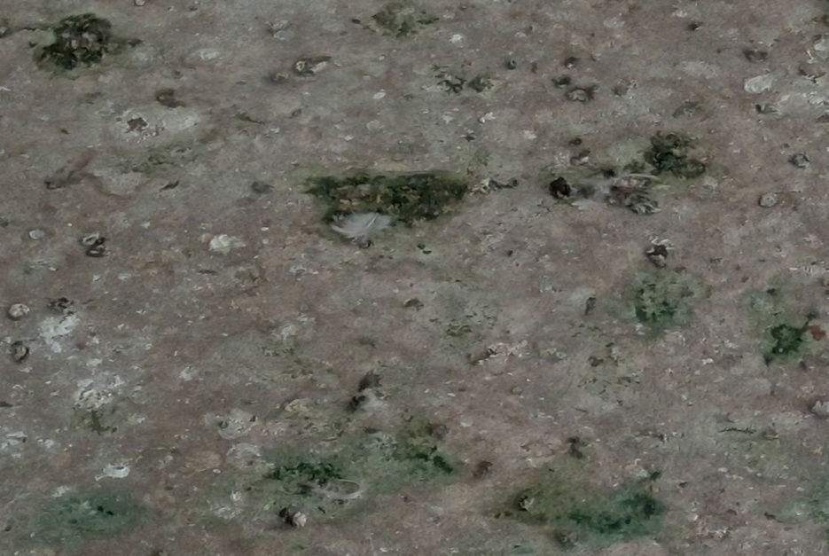
Clinical signs
Anorexia
Torticolis
Greenish diarrhea
Reduced fertility

Slide 10
Epidemic pattern
S.No | Variety of bird | Morbidity rate (%) | Case fatality rate (%)
1. | Fancy Pigeon | 28.94 | 50.66
2. | Grey parrot | 0 | 0
3. | Desi chicken | 0 | 0

Slide 11
Specimen processing
S.No | Type of samples
1 | Nun- tissue sample
2 | black pigeon -Dung sample
3 | Bokero - Brain sample
4 | Bokero - Liver sample
5 | English long face - Intestine sample
6 | English long face - Muscle sample
7 | English long face- Cloacal swab

Slide 12
NDV matrix protein - PCR result

Slide 13
Screening of samples
S.No | Sample details | NDV Matrix protein (232 bp) | PPMV Fusion protein (356 bp)
1 | Nun - tissue | Positive | Negative
2 | black pigeon- dung | Negative | Negative
3 | Bokero- brain | Positive | Negative
4 | Bokero - liver | Negative | Negative
5 | English long face - intestine sample | Positive | Negative
6 | English long face - Muscle | Negative | Negative
7 | English long face- Cloacal swab | Positive | Negative

Slide 14
Therapeutic plan
Separation of affected flock
Separation of Desi chicken
Grey parrot – Higher vigil
Biosecurity at the whole
Genotype II – ND clone 30
IgY
Supplements to improve health and immunity

Slide 15
Therapeutic plan
Geno type II vaccine
Birds with clinical signs like anorexia, greenish diarrhoea
IgY
(1 lakh HI units)
Anorexia,greenish diarrhoea and torticolis
25
IgY
(> 5 Lakh HI units)
Anorexia,greenish diarrhoea and torticolis
25
900

Slide 16
Therapeutic outcome
ND clone
50
50
(100%)
IgY
(1 lakh HI unit)
25
18
(72%)
IgY
(5 Lakh HI unit)
25
12
(92%)

Slide 17
HI titer
S.No | HI titer | Percentage
1 | < 1:16 | 47.16
2. | 1:16 | 24.52
3. | 1:32 | 15.09
4. | 1:64 | 5.66
5. | 1:128 | 1.88

Slide 18
Discussion
Exotic Newcastle disease Vs Pigeon paramyxo virus
Geno type II vaccine
Immunoglobulins
Grey parrot – carrier
Frequency and source of purchase
smart quarantine and immunization

Slide 19
Take home message
A regular review of field vaccine strain-response to emerging strains.
Vaccines that matched to circulating strains induce more specific humoral responses.
ND clone 30 efficacy is witnessed
Igy for neurological cases
Purchasing of birds from known source
ND vaccines without biosecurity may not control in endemic countries.

Slide 20
Thank you

